Slide 1

像黑客一样去思考
姚翔
亚洲区总经理
企业安全
惠普公司

Slide 2
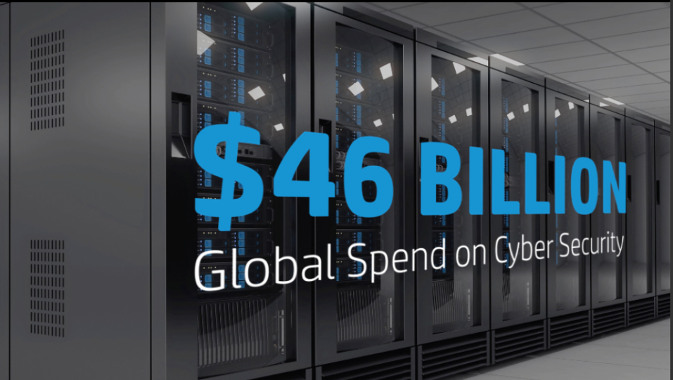
© Copyright 2014 Hewlett-Packard Development Company, L.P. The information contained herein is subject to change without notice.

Slide 3
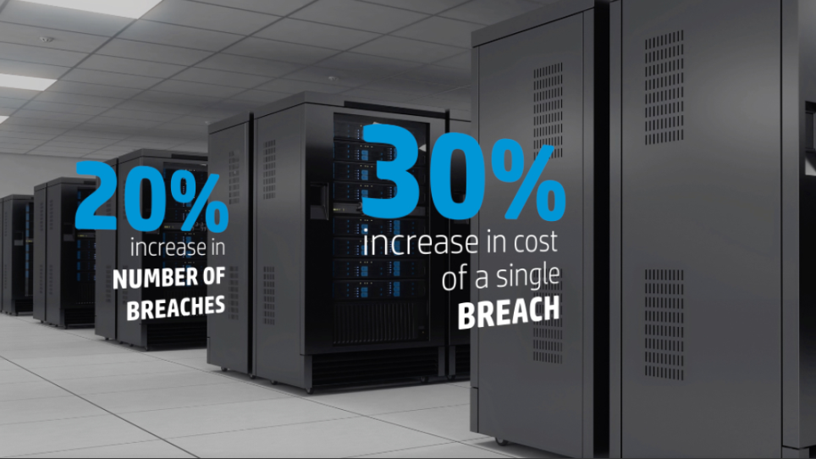
© Copyright 2014 Hewlett-Packard Development Company, L.P. The information contained herein is subject to change without notice.

Slide 4

© Copyright 2014 Hewlett-Packard Development Company, L.P. The information contained herein is subject to change without notice.

Slide 5

© Copyright 2014 Hewlett-Packard Development Company, L.P. The information contained herein is subject to change without notice.

Slide 6


“知己知彼，百战百胜
- 孙子
Notes:
“If you know the enemy and know yourself, you need not fear the result of a hundred battles.”
Very wise words …and as we will see, very relevant today.
So let’s jump in - what is this New Reality?

Slide 7
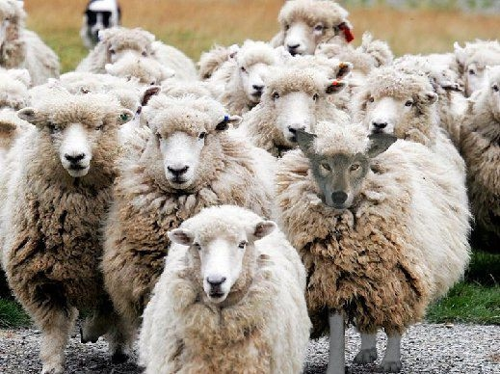
现实的挑战
Notes:
And although my talk today will focus mainly on this new breed of hackers and cyber criminals - let’s not forget about the our trusted employees, contractors, partners – people who already have access to your network. [click] Firewalls and point solutions that detect APTs won’t stop them if they’re the ones trying to steal your data.
[T] A 2013 study done by…

Slide 8

对于安全人员，压力来自于各个方面
Notes:
That egg – that egg in the middle is us. Today’s CIO’s and security leaders are under enormous pressure from this New Style of IT, regulations & compliance, and a competitive business environment moving at the speed of light. On top of that, we also need to be seen as more than a gatekeeper, but rather an enabler of business. We need to ensure our workers stay productive while at the same time, we are fighting this war against the adversary.
And while we are working to protect our environments, we need to ensure we are covering all the bases – we have to make the all right moves, every time – [pause] but our adversary only has to be right once to be successful against us. [pause]
So we have a picture of our enemy, the Adversary. And we know about Ourselves and the challenges we have to keep our environments secure while we our businesses continue to innovate.
[T] So what else do we know about the Adversary and how they work to defeat our security?

Slide 9
云
IT新变革
移动计算
大数据
Notes:
A new style of IT is emerging, promising simplicity, greater agility, speed, and lower cost. People’s desire for anytime, anywhere access is driving the move towards mobile, which is being enabled by the cloud. The combination of these two is creating new and exciting ways for people to communicate and collaborate, this creates an added facet to the security situation that companies are facing. Then there’s Big Data – Making better use of the data you have, so you can run your business better. Big data is about being able to analyze the data in your environment so that you can find the big insights that will help your organization do what it does better. What are the risks? We are creating mountains of structured and unstructured data, and in particular that unstructured data is difficult to manage and protect. And data in the wrong hands can lead to lost Intellectual Property or customer data.
The reality is that we as IT professionals are constantly innovating so that we can compete more effectively and taking offerings to market faster. And, inadvertently, we are creating more vulnerabilities in our IT infrastructure for these criminals to exploit.
So we have this New style of IT that’s transforming enterprises at light speed and security is barely keeping up - and our Adversaries know this….

Slide 10
黑客生态系统
研究
渗入
发现
黑客生
态系统
企业
捕获
渗出
Notes:
So we are dealing with an entire economy of adversaries in a black market.
Where millions of dollars are changing hands
Where individuals specialize in what they do and specialize in how they can hurt our customers
We need to organize our capability to disrupt this market – but first we need to understand how this market operates.
[Kill Chain] The First type of specialist in this market is an expert at research
These actors use all of the information that we create on the internet…Facebook, twitter, linked-in, public directories, blogs…and they figure out who are the top executives of the target company…and perhaps the finance and network administrators…and they craft phishing emails with malware designed to steal their credentials and ultimately they gain usernames and passwords to gain entry to their systems…once done, they hold up their hands in this market and say “I’ve got 20 sets of legitimate credentials for Company X, who wants to buy them?”
[Click]
Usually an individual or team that specializes in infiltrating - in breaking into anything, any technology, hardware, software, even into machines or buildings - They buy that research. Once they break-in, they typically go back to the marketplace and hold up their hands and say “I’ve got 20 access points into Company X, who wants to buy them?” They make a lot of money selling those access points to the next type of specialist, who is an expert in discovery
[click]
These individuals are really good at staying invisible and can stay persistent for years inside a customer’s environment mapping the network, typically looking for key systems that house sensitive data and IP. After they build the maps of the victim’s network showing the location of key systems and data, they will hold their hands up in this new marketplace and sell that information….
[click]
They sell it to individuals who are specialists at capturing and removing the data, sometimes huge amounts of data, without being detected. These experts create a plan using the roadmaps, and steal credit card, IP or whatever sensitive data might be worth a lot of money on the black market
[click]
Then in the final step, they wait for the right moment and remove the targeted assets and work as brokers with criminals to sell those assets back into the market
{APT1 Story]
Transition - So we were in compliance, we had invested in security with Firewalls, AV, logging…yet we were still breached. Recent studies by HP Security, Mandiant and others reveal that my experience was not unique…

Slide 11

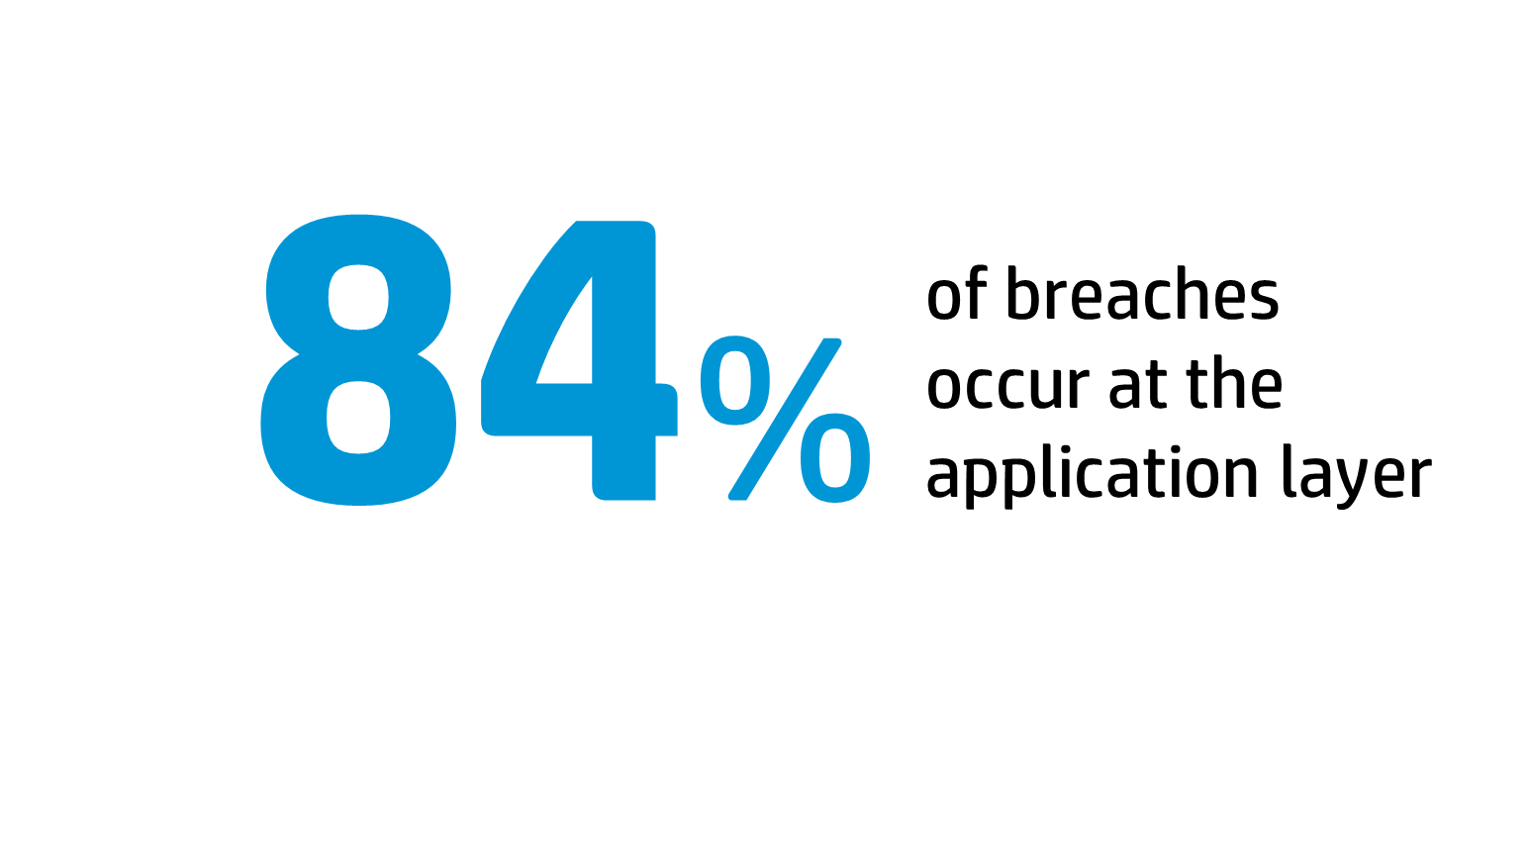
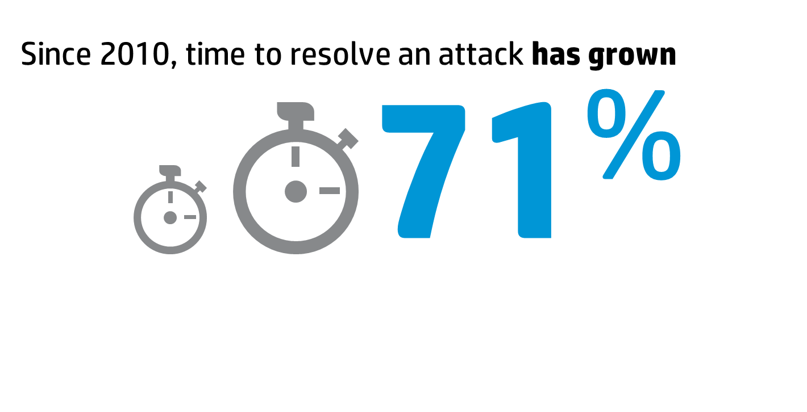
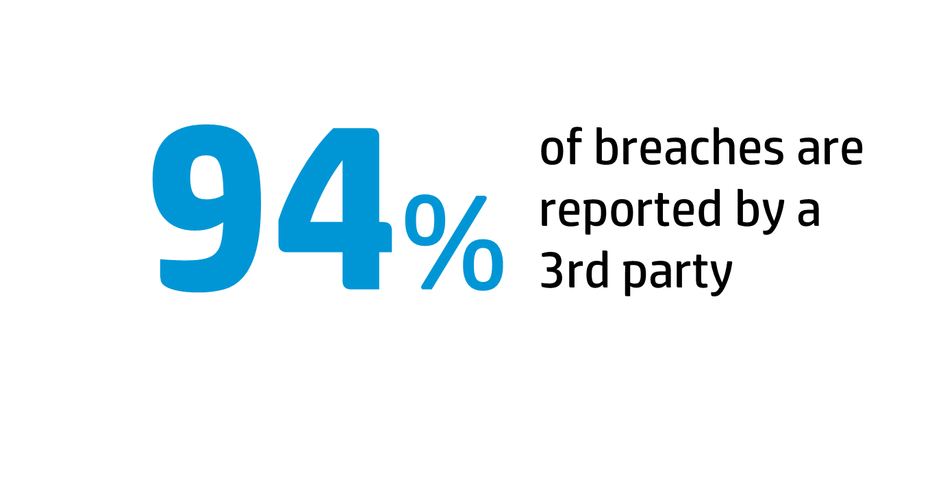



243
^{days}
平均发现破坏时间
2013 January February March April May June July August September October
自从2010年，花费在解决破坏的时间上涨了
破坏发生在应用层
破坏被第
三方披露

Slide 12
















信息安全面临的 挑战
1
黑客主动攻击
(知名企业,竞争对手)
研究
渗透
发现
捕获
外泄
2
传统 信息化向新型转变
(商业模式，消费习惯的改变)
传统网络
私有云
托管云
公有云
消费类设备
虚拟桌面
笔记本电脑
平板设备
智能手机
3
管理带来的 压力
(成本增加，复杂性增加)
Basel III

Slide 13
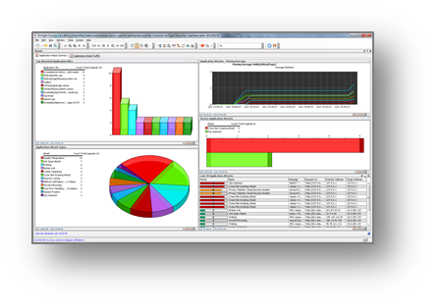

我们需要针对现实改变战略
Notes:
If we are to win against this new Adversary – in this new reality…we need to think differently about this…[read slide]
Successful security leaders have evolved beyond defending the perimeter. They understand this new adversary is already in our network and it’s really a matter of us stopping them before they reach their objective.
What they’ve learned is that relying primarily on perimeter defenses is no longer effective as mobile, cloud and VPNs can circumvent the firewall. And traditional endpoint protection only detects known malware threats. Today you must have intelligent security systems - the most current security and threat intelligence baked into a true defense in depth strategy - which should include SIEM, NGIPS and Application monitoring, preferably with built in workflows and automated incident response capability.
How do we do this? Can we afford all this?

Slide 14
新型的信息安全攻击
搜索
渗透
发现
对手的生态系统
我们的企业
捕获
外泄

Slide 15
如何应对新型的信息安全攻击
安全情报研究
研究
渗透
发现
对手的生态系统
我们的企业
捕获
外泄

Slide 16



惠普安全研究
创新研究
SANS, CERT, NIST, OSVDB, software, and reputation vendors
~3000 专家
2000+ 客户资源共享
7000+ 全球网络托管
Ecosystem partner
信息安全智能
自动集成惠普其它产品
惠普发现的安全漏洞超过市场发现总和
过去三年顶级信息安全漏洞研究机构
—Frost & Sullivan
HP Security Research
ESS
信息安全研究领域的领导者
Notes:
Innovative Research
Driving ESP Security Strategy
Experts in vulnerability, malware, threat actor, and software security research
ZDI and other communities
Globally-distributed team from top universities
Actionable Security Intelligence
Content powers ArcSight, Fortify, and TippingPoint
Intelligence delivered direct to end-users and the public
Regular threat briefings on the Web and iTunes
Thought Leadership On Critical Topics Today
Publications on research spanning the ESP portfolio
Speaking at top security conferences / tradeshows
Trusted-source partner on enterprise security

Slide 17
如何应对新型的信息安全攻击
安全情报研究
研究
阻断访问
渗透
发现
对手的生态系统
我们的企业
捕获
外泄

Slide 18



HP Tipping Point 是网络安全的 领导者
简单
易用，安装配置
集中化管理
高效
行业领先的 安全智能，特征库实时更新
可靠
NGIPS 99.99999% 网络可靠性记录
Notes:
Industry leading security intelligence with weekly DVLabs updates
Easy to use, configure and install with centralized management
NGFW built on 99.99999% network uptime track record

Slide 19
惠普Fortify 保护企业应用系统的 安全
In-house
Outsourced
Commercial
Open source
应用评估
软件安全保障
应用保护
评估
发现各种类型软件
应用的安全缺陷
保障
在上线运行之前检测
出软件安全漏洞
保护
检测与保护在运行
状态的应用系统

Slide 20
如何应对新型的信息安全攻击
安全情报研究
研究
阻断访问
渗透
发现
发现异常
对手的生态系统
我们的企业
捕获
外泄

Slide 21
信息安全是个复杂的工程, ArcSight 可以帮你….
更加可控
利用安全智能
更加有效地
保护大数据资产
更有效率
更加快速简便地
判别系统中
存在的风险
更加合规
自动进行
合规性检测
Notes:
Industry leading security intelligence with weekly DVLabs updates
Easy to use, configure and install with centralized management
NGFW built on 99.99999% network uptime track record

Slide 22
如何应对新型的信息安全攻击
安全情报研究
研究
阻断访问
渗透
发现
发现异常
对手的生态系统
我们的企业
保护目标资产
捕获
外泄

Slide 23
惠普HAVEn助力大数据管理与安全
HP ArcSight with Autonomy IDOL
IDOL
人工
产生
数据
机器
产生
数据
ESM

Slide 24
如何应对新型的信息安全攻击
安全情报研究
研究
阻断访问
渗透
发现
发现异常
对手的生态系统
我们的企业
保护目标资产
捕获
降低损失
外泄

Slide 25


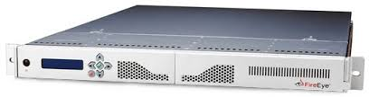


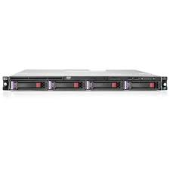



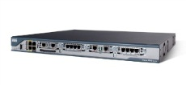

惠普+趋势科技
internet
Perimeter
LAN
OA
SMS
DMZ

Slide 26
HP 安全 - 这些数据让您信赖
HP 安全技术
HP 安全 SaaS
HP 企业安全客户
新产品
#1
10000+
2.5B
客户
35
行的代码通过
SaaS 模式
#2
在市场上的位置
900+
款新产品在未来12个月
托管客户
9 out of 10
9 out of 10
10 of 10
重要银行
领先软件公司
领先电信公司
网络安全
应用安全
信息安全
支付和数据通信

Slide 27


不战而屈人之兵，善之善者也
-孙子
Notes:
Security is no longer about keeping them out – it’s about keeping them from taking what matters most to you.
Today, effective end to end security requires a new approach and a new way of thinking about our enemies.
As Sun Tzu once instructed us to Know your enemy and know yourself, he also said [click]
The opportunity to secure ourselves against defeat lies in our own hands.
Ancient wisdom vs. a modern foe. This is Security for the New Reality.

Slide 28



Slide 29
Thank You!

